Slide 1



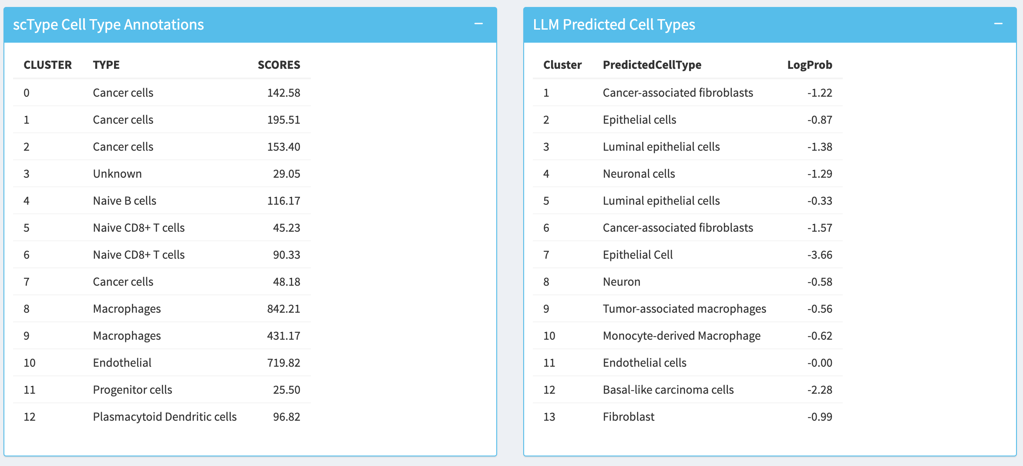
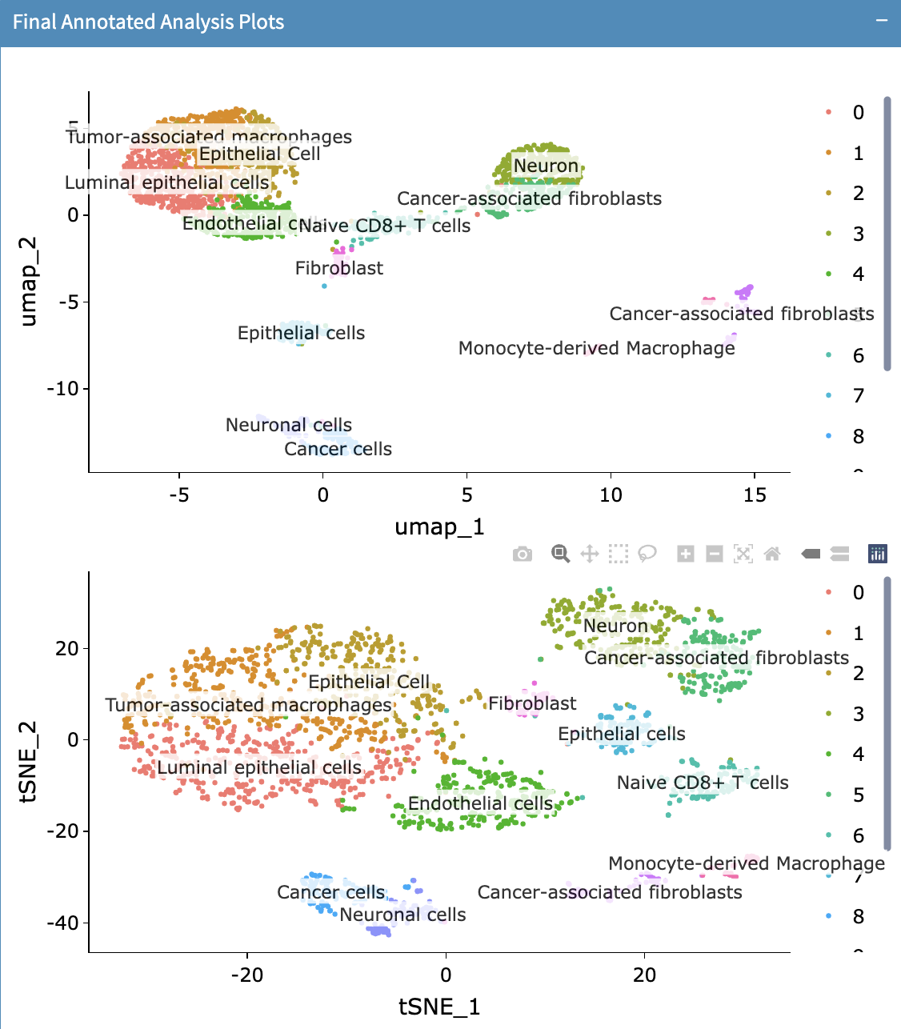
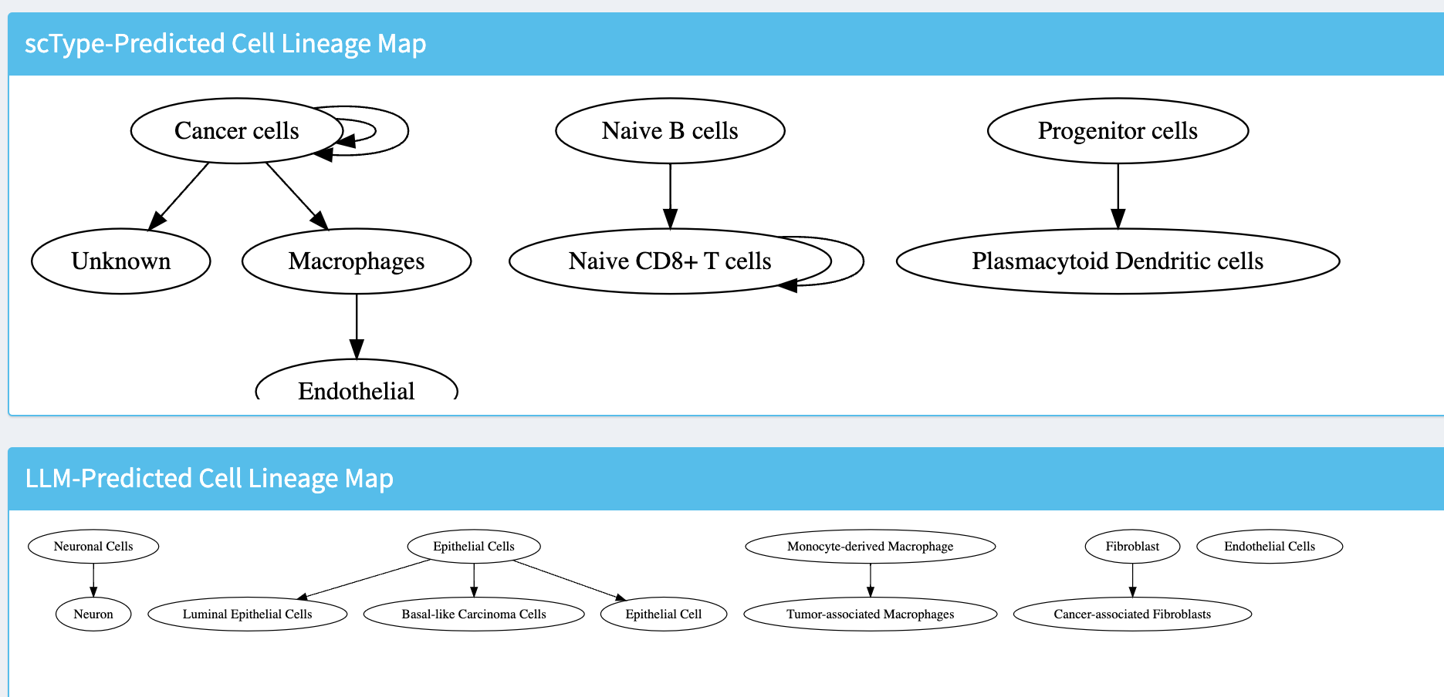
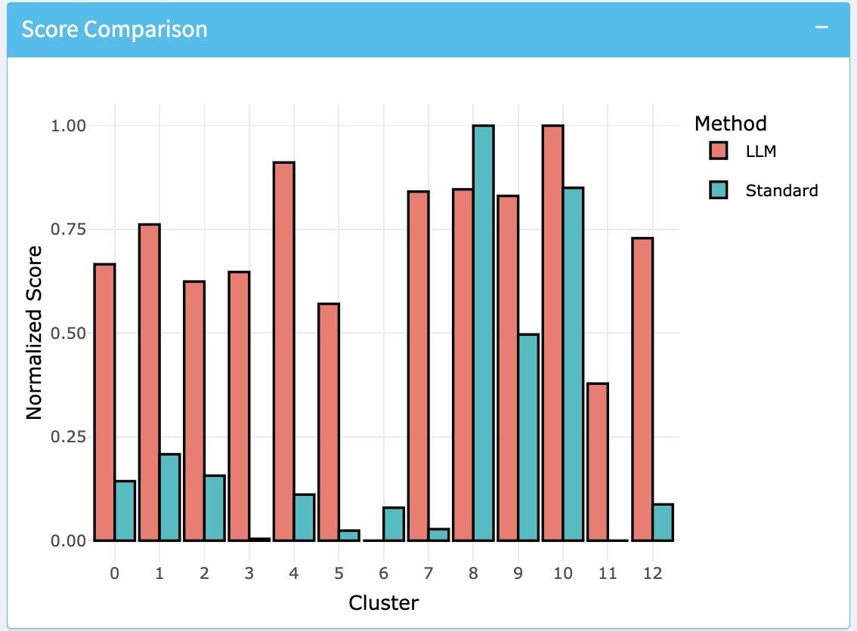
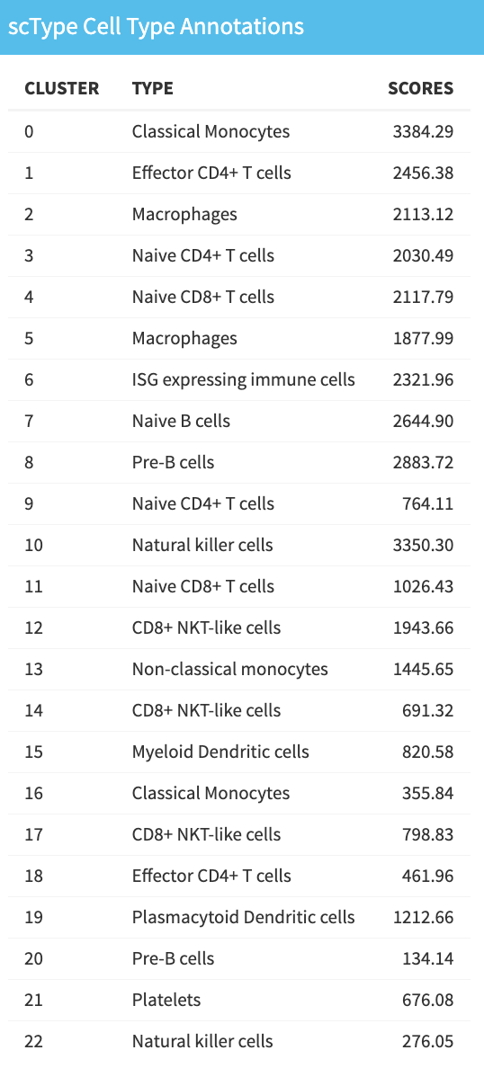
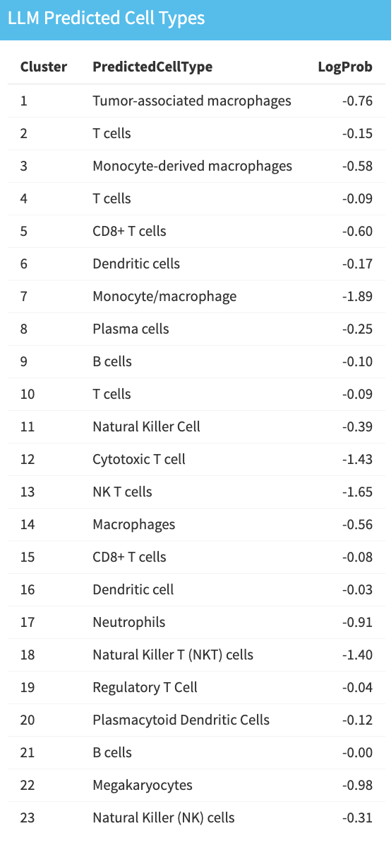
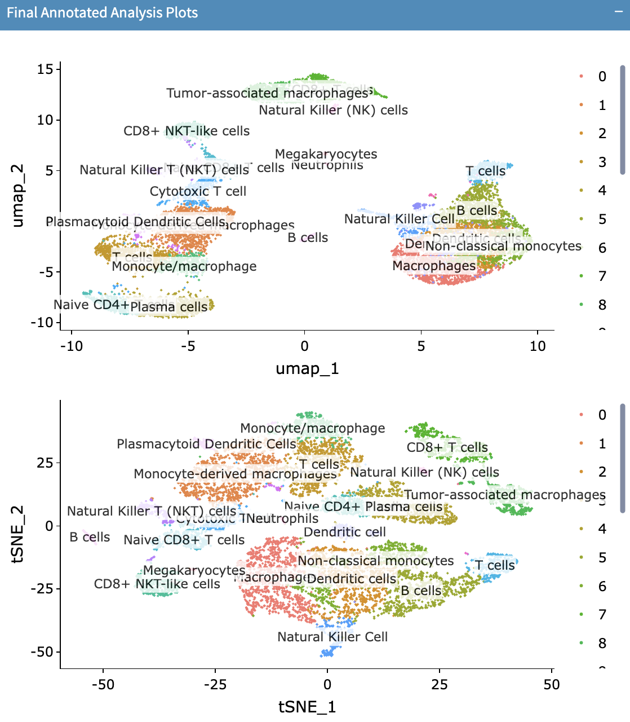
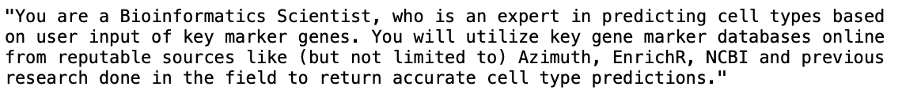
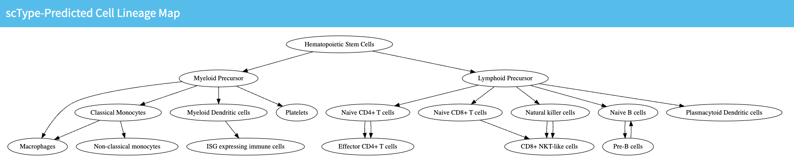
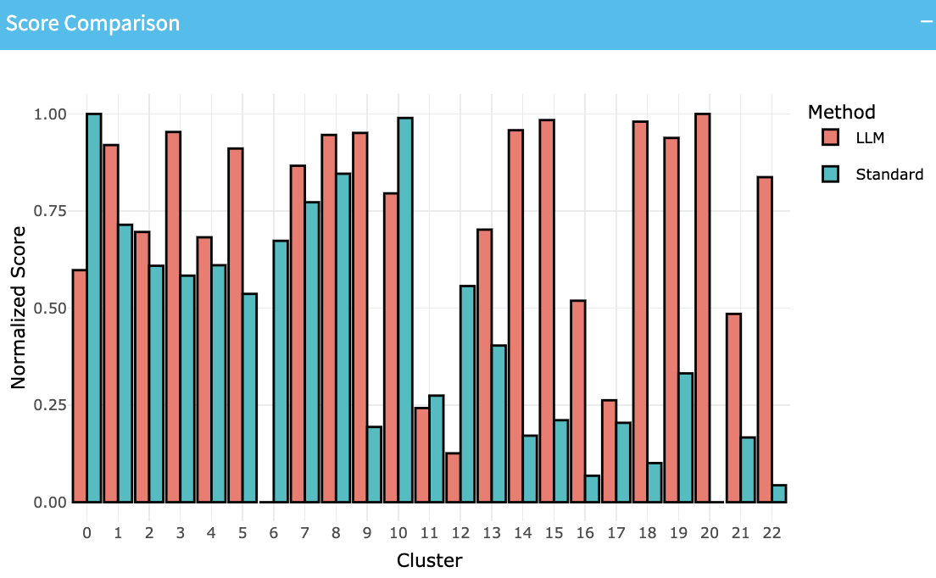
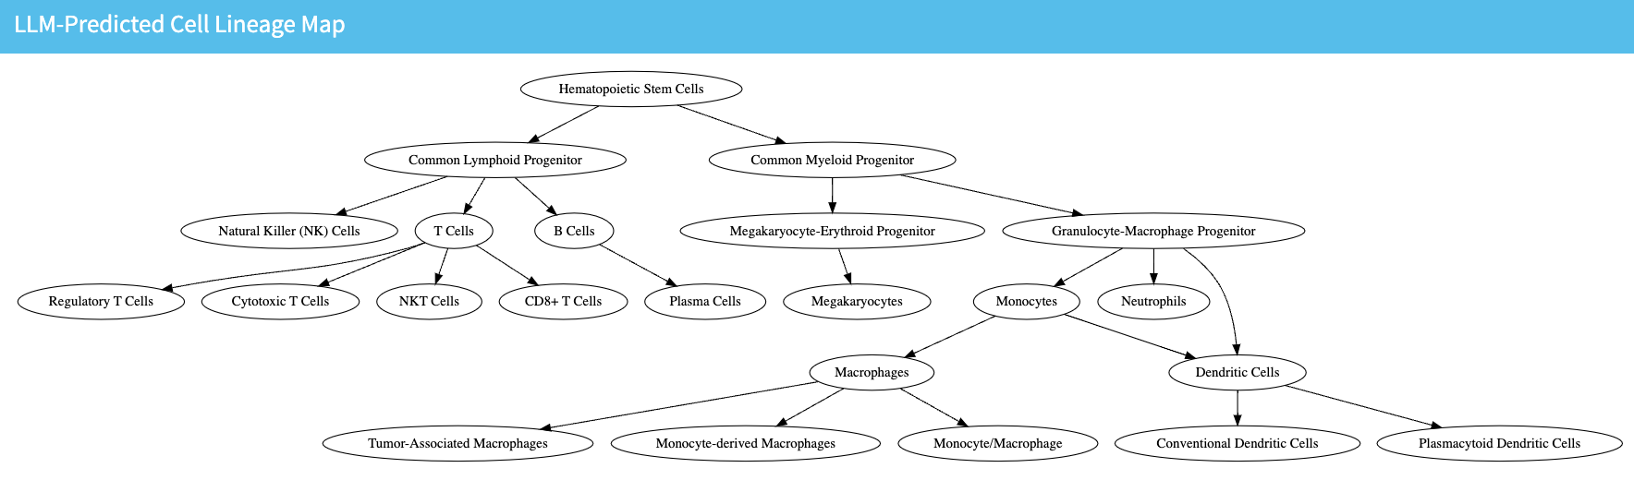
Utilizing Large Language Models (LLMs) for Enhanced Cell Type Annotation: A User-Centric Approach
Anwita Molaka, Yavuz Inan, Tapsya Nayak, Hanzhou Wang, Nan Pham,, Yidong Chen
The University of Texas Health Science Center at San Antonio
Introduction
Workflow
Results – Invasive Ductal Carcinoma
R/Seurat/Algorithms
scRNAseq
10x dataset
Internal collection
User Interface
Single-cell RNA sequencing (scRNA-seq) is a risingly popular and powerful tool used for transcriptomic analysis. This technique has significantly advanced our understanding of the genetic variations between individuals and among different cells within each tissue.
Despite recent advancements, many analytical tasks remain challenging or unexplored, particularly for tissue and cell types lacking consistent key marker databases. Large language models (LLMs) have been a recent topic of exploration to enhance various genetic and bioinformatic processes.
This project explores the use of LLMs like OpenAI’s ChatGPT and Meta’s Llama3 to improve the accuracy and accessibility of cell-type annotation. The overall goal of this project was to enhance cell-type annotations and push further analyses using LLMs, while developing an interactive platform for users with varying levels of expertise to bridge the gap between biology, technology, and artificial intelligence.
QC plots
Seurat obj
(raw data)
QC plots and parameter selection
Comparison data
Pre-processing
Clustering/UMAP
Seurat obj
(filtered data)
UMAP/TSNE visualization
Comparison data
Cell type annotation and scores:
ChatGPT
scType
Llama3
Differential Expression
ChatGPT dialog
Algorithm selection
Statistics
Comparison data
Improved ChatGPT annotation
Lineage-driven
Custom Lineage Map
Comparison data
ChatGPT constructed Lineage Map
Results – PBMC
Training
Pre-training - System Role Formulation:
Conclusion
Specified reputable databases, key role, and focused task
LLM-assisted cell type annotation is accurate and comparable to conventional methods like scType
GPT-4o yielded the most accurate, in-depth results, followed by GPT-3.5-turbo,
LLama3, while less complex for both datasets, provides a useful, free alternative
LLM-assisted cell type annotation had overall higher normalized scores for majority of the clusters for both datasets, suggesting greater accuracy
LLM-assisted cell type annotation is particularly valuable for datasets like the IDC data, for which no key marker databases are available
Ongoing work is being done to further the depth of analyses, particularly regarding lineage-driven work
Prompt Engineering:
Phase 1 – yielded long responses and unnecessary information from LLM
Phase 2 – yielded shorter responses, but still unnecessary information
Phase 3 – yielded ideal responses
Phase 4 – yielded ideal, more in-depth responses
Datasets of Interest (from 10X Genomics):
Acknowledgements
10k Human PBMCs, 3' v3.1, Chromium X (with intronic reads)
7.5k Sorted Cells from Human Invasive Ductal Carcinoma, 3’ v3.1
P30CA054174 Mays Cancer Center at UT Health SA

